Slide 1

School of computer science & engineering
VISION AI VOICE ASSISTANT
Team Members are:-
1:-Shivam Pandey 21SCSE1010177
2:-Ayush Gupta 21SCSE1300004
3:-Yuvraj Sharma 21SCSE1011317
4:-Sparsh Sharma 21SCSE1010185

Slide 2
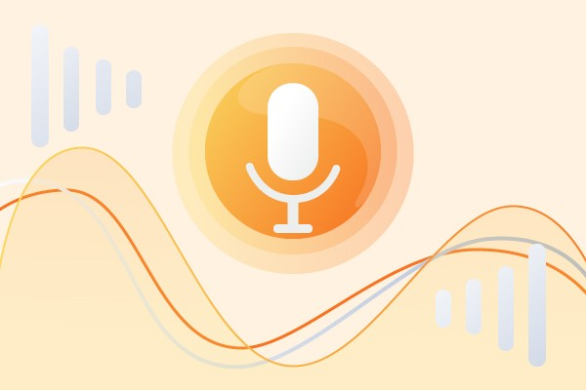
School of computer science & engineering
Voice Assistant
• Voice Assistant is a virtual assistant that uses speech recognition, natural language processing and speech synthesis to take actions on user utteracnes to help its users.
• Voice Assistants have become synonymous with Google Home and Amazon Echo.
• This perception cannot be more wrong. Underlying technology powering both these smart speakers are the actual voice assistants, Google Assistant and Amazon Alexa, respectively.
• Today voice assistants are not limited to smart speakers but are also available in cars, household devices, smartphones, and several apps. on Voice Assistants here.

Slide 3
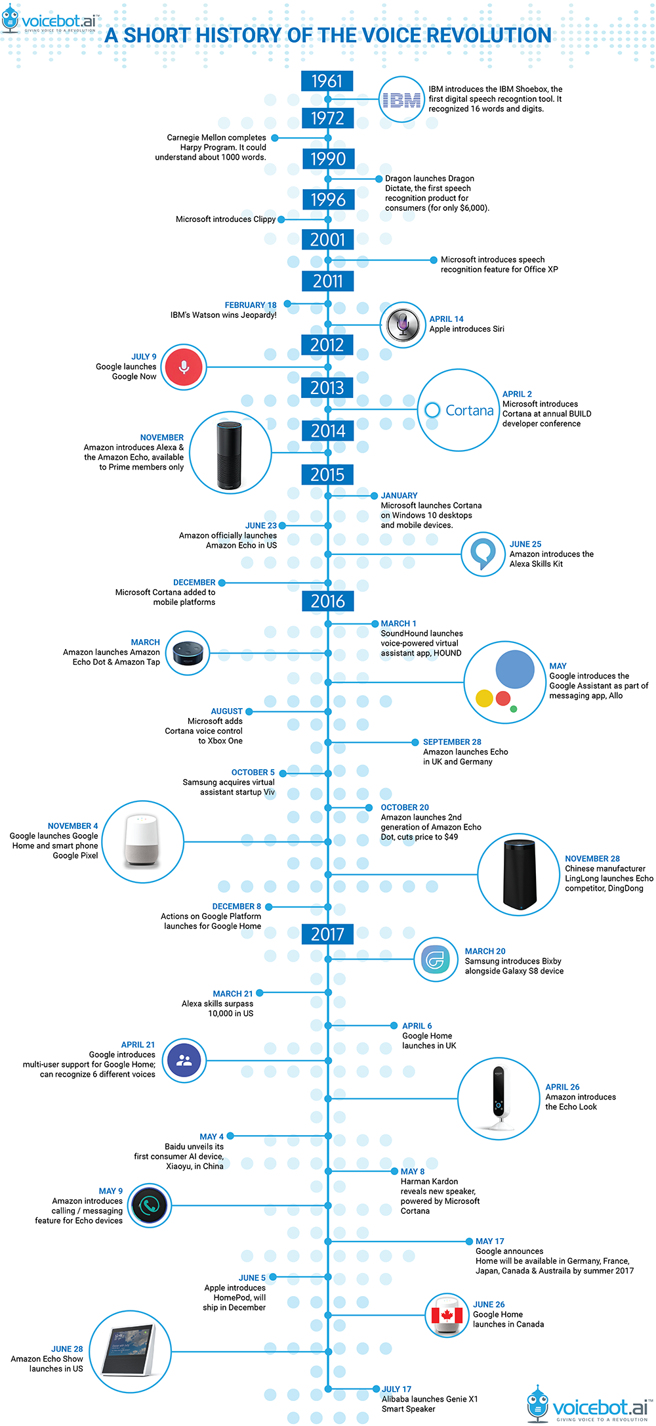
School of computer science & engineering
History of Voice Assistant
• The very first voice-activated product was released in 1922 as Radio Rex. This toy was quite simple, wherein a toy dog would stay inside a doghouse until the user exclaimed its name, “Rex” at which point it would jump out of the house. This was all done by an electromagnet tuned to the frequency similar to the vowel found in the word Rex, and predated modern computers by over 20 years.
• The next decade led to amazing progress and research in the speech recognition field, leading most voice recognition devices from understanding a couple of hundred words to understanding thousands, and slowly making their way into consumers’ homes.

Slide 4
School of computer science & engineering
Growth of Voice Assistant
• Technology is consistently advancing and changing, and therefore the voice assistant market will progress along with it. In April 2015, the research firm Gartner predicted that by the end of 2018, 30 percent of interactions with technology would be through “conversations” with smart machines, many of them by voice. According to Global Market Insights, Inc., between 2016 and 2024, the market share for the technology will grow at an annual rate of almost 35 percent.
• More and more sectors of the economy, like healthcare and the automotive industry, are finding uses for speech recognition technology in addition to those found in devices like smart speakers and phones.

Slide 5
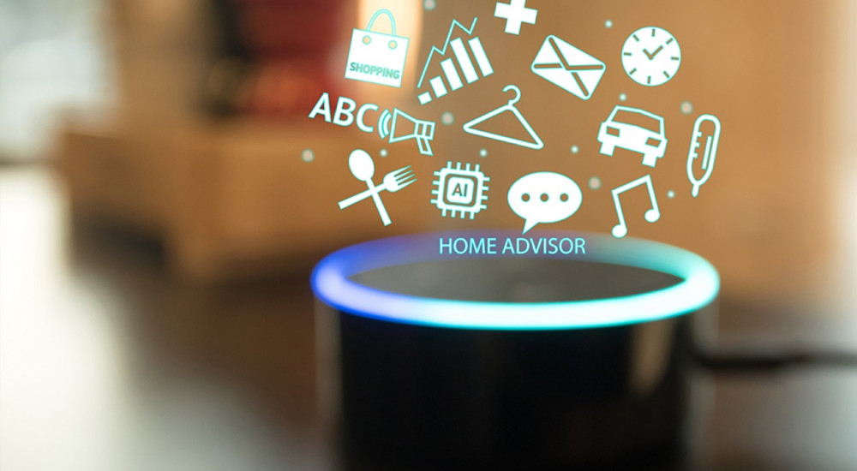
School of computer science & engineering
Future of voice assistant
As AI becomes more advanced and voice technology becomes more accepted, not only will voice-controlled digital assistants become more natural, but they will also become more integrated into more daily devices. Also, conversations will become much more natural, emulating human conversations, which will begin to introduce more complex task flows. More and more people are using voice assistants too, as it was estimated in early 2019 that 111.8 million people in the US will use a voice assistant at least monthly, up 9.5% from last year.

Slide 6
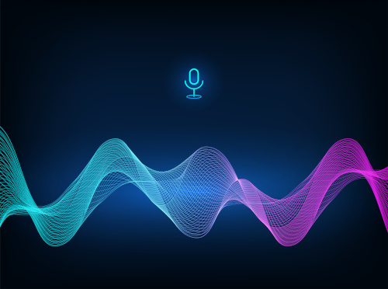
School of computer science & engineering
• In the future, devices will be more integrated with voice, and it will become easier and easier to search using voice. For example, Amazon has already released a wall clock that comes enabled with Amazon Alexa, so you can ask it to set a timer or tell you the time.
• While these devices are not fullblown voice-activated personal assistants, they still show a lot of promise in the coming years. Using vocal commands, we will be able to work with our devices just by talking.

Slide 7
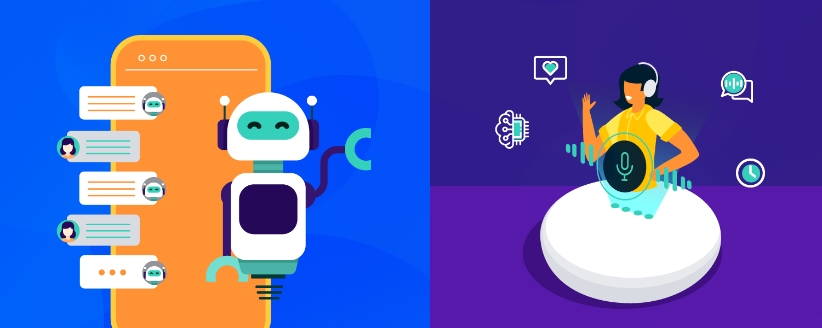
School of computer science & engineering
Advantages of Voice Assistant
• Enhances e-Commerce Marketing
• Provides 24/7 Customer Support
• Eradicates Language Barriers
• Helps Streamline Operations
• Saves Time by Automating
• Repetitive Tasks
• Enables Smart Offices
• Aids Hand-free Operation

Slide 8
School of computer science & engineering
Disadvantages of Voice Assistant
• Smart Home Devices are Expensive
Smart home devices which are controlled by the virtual assistants are expensive, and not everyone can afford them. They also consume a lot of electricity. So, if you have a lot of smart home devices, you can expect to pay a higher electricity bill. When there is no electricity, you cannot use them.

Slide 9
School of computer science & engineering
• Leads to lost concentration on the task in hand
Using a virtual assistant with voice recognition can cause you to lose concentration on the tasks in hand. You are giving attention to the virtual assistant when providing instructions and trying to accomplish the task in hand at the same time. When the attention is divided, you are prone to making a mistake.
• Privacy Concerns If you use a VUI device, your data can get tracked by the manufacturer. There have been complaints about this, for example, the Cambridge Analytica scandal claimed that Google Home and Amazon Alexa are eavesdropping on private conversations. This causes people to have worries about how their private data are being used by these manufacturers

Slide 10
School of computer science & engineering
Our Proposed System:
It was an interesting task to make my own assistant. It became easier to send emails without typing any word, Searching on Google without opening the browser, and performing many other daily tasks like playing music, opening your favorite IDE with the help of a single voice command. Jarvis is different from other traditional voice assistants in terms that it is specific to desktop and user does not need to make account to use this, it does not require any internet connection while getting the instructions to perform any specific task.
The IDE used in this project is PyCharm. All the python files were created in PyCharm and all the necessary packages were easily installable in this IDE. For this project following modules and libraries were used i.e. pyttsx3, SpeechRecognition, Datetime, Wikipedia, Smtplib, pywhatkit, pyjokes, pyPDF2, pyautogui, pyQt etc. I have created a live GUI for interacting with the JARVIS as it gives a design and interesting look while having the conversation. With the advancement JARVIS can perform any task with same effectiveness or can say more effectively than us. By making this project, I realized that the concept of AI in every field is decreasing human effort and saving time.
Functionalities of this project include, It can send emails, It can read PDF, It can send text on WhatsApp, It can open command prompt, your favorite IDE, notepad etc., It can play music, It can do Wikipedia searches for you, It can open websites like Google, YouTube, etc., in a web browser, It can give weather forecast, It can give desktop reminders of your choice. It can have some basic conversation.

Slide 11
School of computer science & engineering
Tools and Technology Used:
SOFTWARE REQUIREMENT:
As the project is developed in python, we have used Anaconda for Python 3.6.5 and PyCharm.
1 Anaconda
It is a free and open-source distribution of the Python and R programming languages for data science and machine learning related applications (large- scale data processing, predictive analytics, scientific computing), that aims to simplify package management and deployment. Package versions are managed by the package management system conda. The Anaconda distribution is used by over 6 million users, and it includes more than 250 popular data science packages suitable for Windows, Linux, and MacOS.
PyCharm: -
It is an IDE i.e. Integrated Development Environment which has many features like it supports scientific tools(like matplotlib, numpy, scipy etc) web frameworks (example Django,web2py and Flask) refactoring in Python, integrated python debugger, code completion, code and project navigation etc. It also provides Data Science when used with Anaconda.
Features include:
editor with syntax highlighting and introspection for code completion
support for multiple Python consoles (including IPython)
the ability to explore and edit variables from a GUI

Slide 12
School of computer science & engineering
Available plugins include:
Static Code Analysis with Pylint
Code Profiling
Conda Package Manager with Conda
Hardware Interfaces
Processor : Intel CORE i5 processor with minimum 2.9 GHz speed.
RAM : Minimum 4 GB.
Hard Disk : Minimum 500 GB
Software Interfaces
Microsoft Word 2007
Database Storage : Microsoft Excel
Operating System : Windows10

Slide 13
School of computer science & engineering
PROJECT FEATURES:-
• The functionalities include, It can send emails, It can read PDF, It can send text on WhatsApp, It can open command prompt, your favorite IDE, notepad etc., It can play music, It can do Wikipedia searches for you, It can open websites like Google, YouTube, etc., in a web browser, It can give weather forecast, It can give desktop reminders of your choice. It can have some basic conversation.
• Tools and technologies used are PyCharm IDE for making this project, and I created all py files in PyCharm. Along with this I used following modules and libraries in my project. pyttsx3, SpeechRecognition, Datetime, Wikipedia, Smtplib, pywhatkit, pyjokes, pyPDF2, pyautogui, pyQt etc. I have created a live GUI for interacting with the JARVIS as it gives a design and inte resting look while having the conversation.

Slide 14
School of computer science & engineering
Sr. no | Paper Title | Year | Methodology | Future scope
1.) | Voice assistant AI-based | 2021 | “Working of the AI” | We can see the behavioral changes .
2..) | Acceptance-Relevant factors of virtual voice assistant | 2020 | “Listening and recognizing” | All searches across the internet will be voice based.
3..) | Voice assistant and AI’s future. | 2019 | “Give the user relevant information about his inquiry” | It will increase more personalized experience.

Slide 15
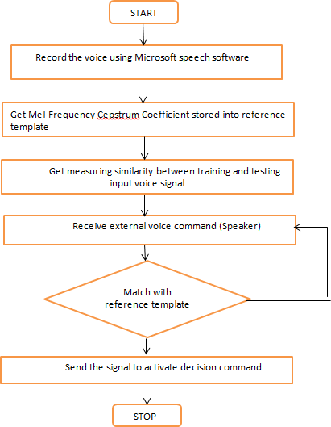
School of computer science & engineering
Flowchart :-

Slide 16
School of computer science & engineering
Thank You…..

